Slide 1
Chapter 4: Measures of Location
(part 2)

Slide 2
Learning Outcomes
After Completing the chapter ,you will able to :
Compute the different types of measures of location.
Understand the applications of different types of measures of location.
Box plot and construction process of box plot.

Slide 3
Contents
From this lecture, you are going to learn…
Construction of Box-Whisker-Plot
Uses of it

Slide 4
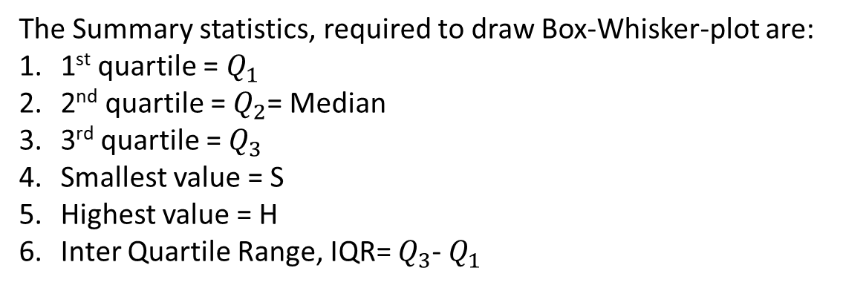
Box-Whisker plot
The Summary statistics, required to draw Box-Whisker-plot are:
1st quartile = $Q_{1}$
2nd quartile = $Q_{2}$= Median
3rd quartile = $Q_{3}$
Smallest value = S
Highest value = H
Inter Quartile Range, IQR= $Q_{3}$- $Q_{1}$

Slide 5




Box-Whisker plot
The fences to detect outliers in the Box-Whisker-Plot are:
Inner Fences:
Outer Fences:
$Q_{1}$-1.5$×$IQR
$Q_{1}$- 3$×$IQR
&
&
$Q_{3}+$1.5$×$IQR
$Q_{3}+$ 3$×$IQR

Slide 6


Box-Whisker plot
Example: The monthly starting salaries in dollar for a random sample 12-business school graduates are as follows:
2900, 2765, 2960, 2890, 2880, 2720, 2930, 2950, 2860, 3060, 3260, 3525
Solution:
Arranging the data to the smallest to largest,
2720, 2765, 2860, 2880, 2890, 2900, 2930, 2950, 2960, 3060, 3260, 3525
1. Position of 1st quartile $Q_{1}$= $\frac{1×12}{4}$= 3
$∴$1st quartile $Q_{1}$= $\frac{3rd+4th}{2}$= $\frac{2860+2880}{2}$ = 2870

Slide 7




Box-Whisker plot
2729, 2765, 2860, 2880, 2890, 2900, 2930, 2950, 2960, 3060, 3260, 3525
2. Position of 2nd quartile $Q_{2}$= $\frac{2×12}{4}$= 6
$∴$2nd quartile $Q_{2}$= $\frac{6th+7th}{2}$= $\frac{2900+2930}{2}$ = 2915
3. Position of 3rd quartile $Q_{3}$= $\frac{3×12}{4}$= 9
$∴$3rd quartile $Q_{3}$= $\frac{9th+10th}{2}$= $\frac{2960+3060}{2}$ = 3010

Slide 8
Box-Whisker plot
2720, 2765, 2860, 2880, 2890, 2900, 2930, 2950, 2960, 3060, 3260, 3525
4. Smallest value = 2720
5. Highest value = 3525
6. Inter Quartile Range, IQR =$Q_{3}$-$Q_{1}$ = 3010-2870= 140

Slide 9




Box-Whisker plot
2729, 2765, 2860, 2880, 2890, 2900, 2930, 2950, 2960, 3060, 3260, 3425
Inner Fences:
Outer Fences:
$Q_{1}$-3$×$IQR = 2870- 3*140=2450
$Q_{1}$-1.5$×$IQR = 2870- 1.5*140=2660
&
&
$Q_{3}+$1.5$×$IQR = 3010+1.5*140= 3220
$Q_{3}+3×$IQR = 3010+3*140= 3430

Slide 10






Box-Whisker plot
2720, 2765, 2860, 2880, 2890, 2900, 2930, 2950, 2960, 3060, 3260, 3525
Suspected
outlier
Extreme
outlier
Extreme
outlier
Suspected
outlier
3260
*
3525
o
$$Q_{1}$$
$$Q_{2}$$
$$Q_{3}$$
Adjacent
Value =
2720
Adjacent
Value =
3060
$Q_{1}$=
2870
$Q_{2}$=
2915
$Q_{3}$=
3010
Outer
Fence=
2450
Inner
Fence=
2660
Inner
Fence=
3220
Outer
Fence=
3430
Whisker
Whisker

Slide 11
Box-Whisker plot
Uses:
To get idea of the shape of the distribution
To detect outliers from the data.
To get idea about the spread ness of the data set.
From the previous Box-Plot we see that,
1. The shape of the distribution is negatively skewed since left whisker is larger than right whisker.
There are 2 outliers in the data. Which are 3260 and 3430.

Slide 12
Exercise
Construct a Box-and- Whisker Plot for these data and identify if any outliers:
3, 9, 10, 2, 6, 7, 5, 8, 6, 6, 4, 9, 22.

Slide 13


